Slide 1
Leave disease detection system
Abhishree Bisht
2100290130008

Slide 2
Introduction to leave disease
Leaf diseases are a critical concern in agriculture and horticulture, posing significant challenges to plant health and crop productivity.
This presentation aims to provide an overview of leaf diseases, their causes, symptoms, and the importance of early detection and management.
Overview of the causes and factors contributing to leaf diseases.
Importance of understanding and effectively managing leaf diseases for sustainable agriculture and plant health.

Slide 3
CNN with its perk
It's a type of artificial neural network that is primarily used for analyzing visual imagery.
CNNs are highly effective for tasks such as image recognition, object detection, and image classification.
It is composed of multiple layers.
Used variety task like-regression,classification,etc.

Slide 4
Why to use CNN?
Effective Feature Extraction
Adaptability to Variations
Transfer Learning Utilization
Efficient Processing
Automated Detection:

Slide 5
Deployment
Importing necessary libraries
2. Importing and splitting the dataset images
3. Resizing the images and then converted into an array.
4. Splitting the dataset for training and testing.
5. Normalizing the data.
6. Model Building: Sequential model, Adding different layers with filters, flatten, dense etc.
7. Compiling the model based on Binary and Multiclass classification(Softmax/Sigmoid) and then saved.
8. Predicting the tumor using saved model i.e. Binary or Multiclass model.
9. Showing the result.

Slide 6
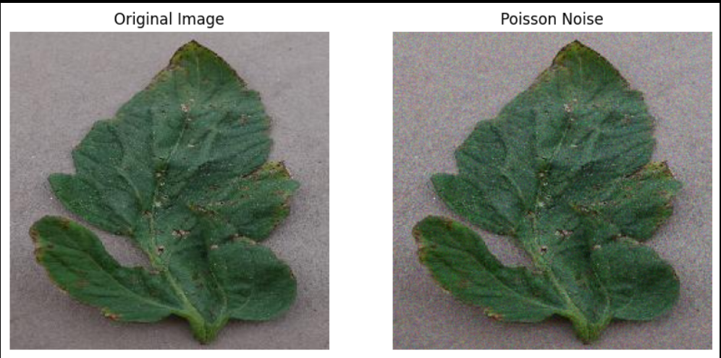
Output
Noise is added

Slide 7
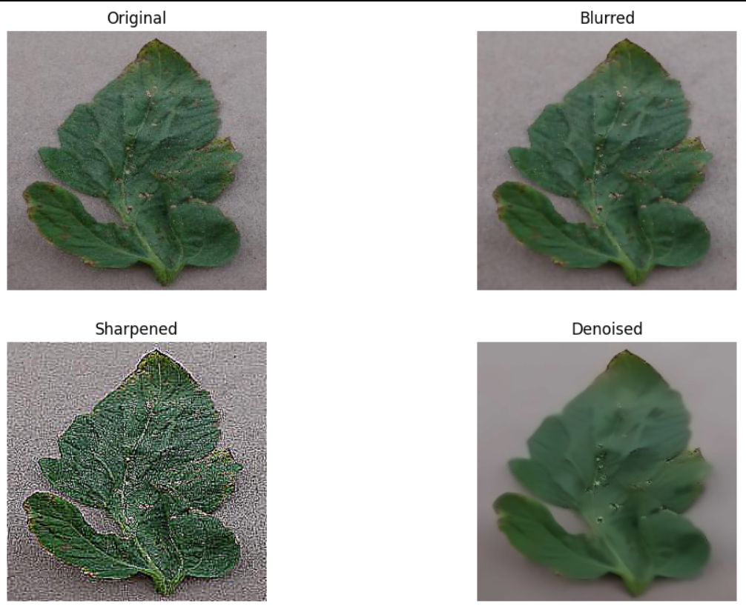
Comparison of Original image with the images having noise .

Slide 8
Thankyou

